Slide 1
Introduction to Decentralized Finance

Slide 2
What is Decentralized Finance?
A new financial system built from the ground up that creates a competitive marketplace of decentralized financial applications.
DeFi uses smart contracts that are recorded and executed on a blockchain to offer financial instruments and services without relying on traditional intermediaries such as brokerages, exchanges, and banks.
It allows participants to lend and borrow funds from others, speculate on price movements on assets using derivatives, trade cryptocurrencies, insure against risks, and earn interests on savings-like accounts.
Five major areas of operation:
Lending
Exchanges
Derivatives
Payments
Asset managements

Slide 3
Differences with traditional finance
DeFi is open access.
It does not need centralized institutions for basic financial actions.

Slide 4
More on the differences
“Trust” is essential for financial markets.
In traditional finance, centralization has been the most effective way to create trust.
Large organizations (central banks, multinational brokerage houses, other financial intermediaries) have the size, brands, products and personnel we consider trustworthy.
DeFi is based on the opposite concept: absence of large organizations like banks that control the operation of the system.

Slide 5
Why do we want to get rid of banks?
Why are some people enthusiastic about getting rid of banks?

Slide 6
I. Trends in financial industry

Slide 7
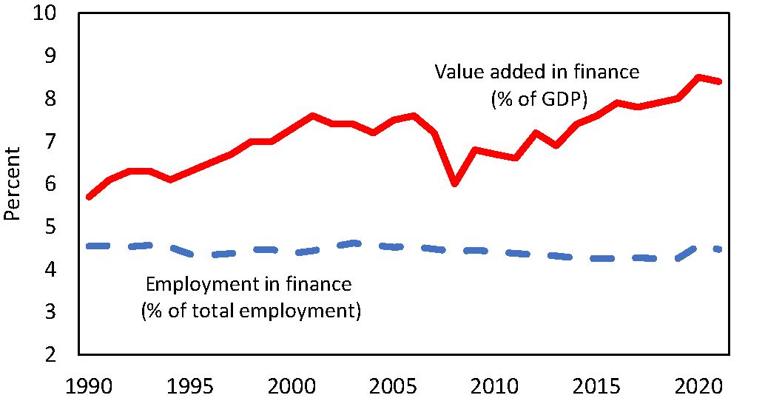
The size of finance

Slide 8
The size finance

Slide 9
Why does finance get a larger
share of income?
Why do we need finance?

Slide 10
The role of banks
Net savers
Banks
Net borrowers
Consumers
Investors
Employers
Consumers
Investors
Employers

Slide 11
Banks are useful.
But why are they getting a larger
share of income?

Slide 12
First (benevolent) view:
Banks contributed to increasing the pie
1990
2021
Banks
Banks
Savers
Borrowers
Savers
Borrowers

Slide 13
First (benevolent) view:
Banks contributed to increasing the pie
1990
2021
Banks
Banks
Savers
Borrowers
Savers
Borrowers

Slide 14
Second (less benevolent) view:
Banks get a larger share of the pie because they became more powerful
1990
2021
Banks
Banks
Savers
Borrowers
Savers
Borrowers

Slide 15
Second (less benevolent) view:
Banks get a larger share of the pie because they became more powerful
1990
2021
Banks
Banks
Savers
Borrowers
Savers
Borrowers

Slide 16
Is there evidence supporting the second view?

Slide 17
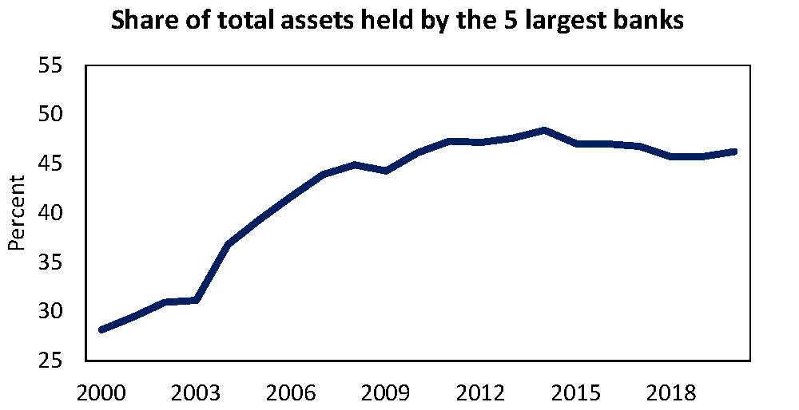






Slide 18
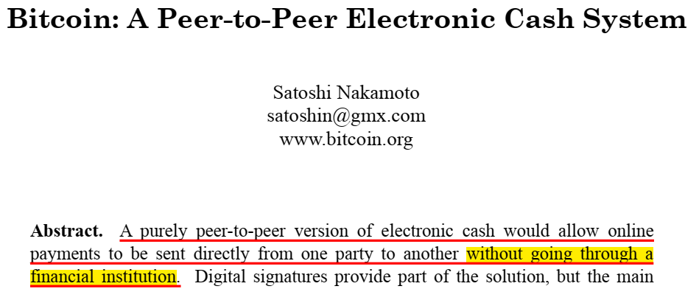

Slide 19
II. Differences with traditional
finance

Slide 20
The role of banks
Net savers
Banks
Net borrowers

Slide 21
DeFi
Net savers
Net borrowers
Computers that execute
pre-programmed codes
designed to do what banks do
Pre-programmed codes are called “smart contracts”
Smart contracts are stored and executed in a “blockchain” by a network of interconnected computers

Slide 22
How do we trust the new system?

Slide 23
“Trust” without a central institution
Large organizations (central banks, multinational brokerage houses, other financial intermediaries) have the size, brands, products and personnel we consider trustworthy.
DeFi is based on the opposite concept: absence of large organizations that can control the operation of the system.
Instead, “Trust” is created through a “consensus” mechanism.

Slide 24
More on the differences?
The new instruments in decentralized financial markets are “security tokens”.
A security token is a digitized form of traditional ownership certificates, giving title to a regulated financial instrument.
The digital form makes it suitable to be recorded and traded in a blockchain platform with greater agility and speed.

Slide 25
III. Benefits of DeFi
vis-a-vis
traditional finance

Slide 26
Does DeFi provide financial services that are fundamentally different from traditional finance?
The answer is NO
DeFi uses a different system to provide the “same” services

Slide 27
What are the problems solved by DeFi?
Centralized control
Limited access
Inefficiency
Lack of interoperability
Opacity

Slide 28
Problems solved by DeFi 1. Centralized control
Many consumers and businesses deal with a single localized bank. Even if it is possible to switch to another bank, it carries direct and indirect costs.
This gives significant market power to the bank allowing less favorable terms for costumers: higher fees, lower interests on deposits, higher interests on loans.
The high concentration of the banking sector with few banks controlling a very large share of the market makes the problem more severe.
DeFi eliminates or at least reduces the centralized control of few players.

Slide 29
Problems solved by DeFi 2. Limited access
Many people around the world are unbanked (they are not costumers of any bank).
Typically, they have modest economic conditions and located in remote areas.
Financial institutions do not find these potential costumers profitable. For example, because these costumers cannot take large loans.
DeFi enhances accessibility for these marginal costumers. All is needed is for them to have an internet connection.

Slide 30
Problems solved by DeFi 3. Inefficiency
The presence of middlemen implies fees that in principle could be avoided or reduced. The high fees could be implicit in the interest spread between deposits and loans.
Explicit fees and interest spreads are necessary for traditional financial institutions to cover the high operational and administrative costs of their complex organizational structure.
DeFi automatizes the functions of the middlemen or intermediary, reducing its cost.

Slide 31
Problems solved by DeFi 4. Lack of Interoperability
Consumers and businesses deal with financial institutions in an environment in which there is very limited sharing of information and operation.
For example, moving money from one institution to another can be lengthy and complicated: A wire transfer could take a couple of days to complete.
A bank has a lot of information about the costumer, but the information is not shared with other banks.
DeFi is based on a highly interconnected system that makes transfer of values faster and cheaper.

Slide 32
Problems solved by DeFi 5. Opacity
Bank costumers have little information about the financial health of their bank. It is difficult for them to figure out whether the conditions offered by a bank is competitive and there are better options in the market.
Regulations and government supervisions are designed to alleviate these problems.
DeFi is based on a set of rules that make the financial health of the participants not an issue. The high interconnectivity and information sharing makes the system highly competitive and reduces the need of government supervision.

Slide 33
Course objective
To understand how the technology works (blockchain).
To understand how the new technological structure affects financial markets.
To understand the possible consequences for businesses.

Slide 34
Course Plan
May 11: Intro to decentralized finance (DeFi).
The architecture of DeFi: Blockchains as platforms for financial applications.
May 13: Continue with the architecture of DeFi.
May 15: The functions of money, cryptocurrencies and stablecoins.
Introduction to Python for finance.

Slide 35
Course Plan (continue)
May 18: Digital assets as an investment vehicle: analysis of risk-return trade-off. Application using Python for financial analysis.
May 20: Continuing with applications of risk-return trade-off using Python.
May 22: Decentralized borrowing, lending and decentralized exchanges.
May 25: Nonfungible tokens (NFTs) and the anatomy of an asset price bubble.
May 27: Student presentations.

Slide 36
Course materials
Published references (only suggested, not required):
Marco Di Maggio, Blockchain, Crypto and Defi, 2025, Wiley.
Eswar S. Prasad, The Future of Money, 2021, Harward University Press. Campbell R. Harvey, Ashwin Ramachandran and Joey Santoro, DeFi and The Future of Finance, 2021, Wiley.
Hands-On Python for Finance, 2019, Packt.
Boom and Bust: A Global History of Financial Bubbles, William Quinn and John D. Turner, 2020, Cambridge University Press.
Makarov, I. and Schoar, A. (2022). Cryptocurrencies and decentralized finance (defi). Technical report, Brookings Papers on Economic Activity.
Slides:
Will be made available before the class meets.
Python programs:
We will use Python for the analysis of financial data. I will provide all info and documentation needed.

Slide 37
Grading policy
A set of 5 homework assignments (each counting 5%) 30%
Group project 20%
Final Exam 40%
Class participation 10%

Slide 38
Technology policy
Laptop are necessary for part of this course.
However, laptops should be used only for the purpose of the class.

Slide 39
Welcome to the course.
I hope you will find the course an enriching and enjoyable learning experience.

